Slide 1


Student Details
Name – Rakshit Bhadoria
SkillsBuild Email ID : rakshitbhadoria04@gmail.com
College Name – KIET Group of Institutions
College State – Uttar Pradesh
Internship Domain – Data Analytics ( 12. June. 2023 to 10. July.2023)

Slide 2
PROJECT TITLE – Case study: Analysis of superstore Problem Statement
The process of looking at a superstore's performance and customer data to find ways to improve and make business operations run as smoothly as possible.

Slide 3
AGENDA
Problem Statement / Project Title
Project Overview
Who are the end Users
Solution & its value proposition
How did you customize the project and make it your own?
Modelling
Results
Links

Slide 4
PROJECT OVERVIEW
The purpose of this study is to learn more about how a superstore works by examining its operations, customer data, and performance measures. Our goal is to improve the superstore's operations, boost the customer experience, and fuel the company's expansion by recommending concrete steps to take based on analysis of past data.

Slide 5
WHO ARE THE END USERS of this project?
The superstore management team, which consists of executives, department heads, and operational staff, are the project's end users. They need information on the store's performance so that they may make informed choices and make adjustments. As a result of this analysis, they will have a better grasp of the store's SWOT (strengths, weaknesses, opportunities, and threats) and be more equipped to make strategic moves toward expanding their business and boosting their customers' happiness.

Slide 6
YOUR SOLUTION AND ITS VALUE PROPOSITION
Solution is to look at the superstore's sales data, and operational metrics, to find patterns, trends, and places where the store could do better. By using advanced analytics techniques, we will provide insights that can be used to solve the problems we've found and improve key performance indicators. The value of our solution lies in its ability to increase business efficiency, drive revenue growth, and improve the customer experience as a whole.

Slide 7
How did you customize the project and make it your own
Even though there may be similar analyses for superstores, we have tailored our method to meet the specific requirement and challenges of the target store.
We used domain-specific knowledge and expertise to make sure that our recommendations are relevant and useful.
Also, our system uses the latest data analytics techniques and tools, which make it possible to get a more complete and accurate picture of how the store is doing.

Slide 8
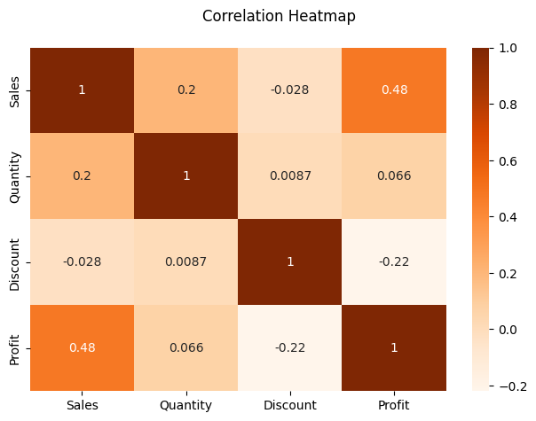
MODELLING
How does Sales, Quantity and Discount affects SuperStore Profits?
Sales and Profit: As sales increase, profits also increase.
Reason : higher sales lead to higher revenue and subsequently higher profits.
Discount and Profit: As discounts are offered on sales, the profit margins decrease.
Reason: While discounts may attract customers and increase sales, they can also erode profit margins if not carefully managed. Customers might think that product quality is not good.
Discount and Sales/Quantity: Surprisingly, the analysis reveals little to no difference in sales and quantity due to discounts.
This suggests that the discount strategy employed by Superstore may not be effective for certain items.

Slide 9
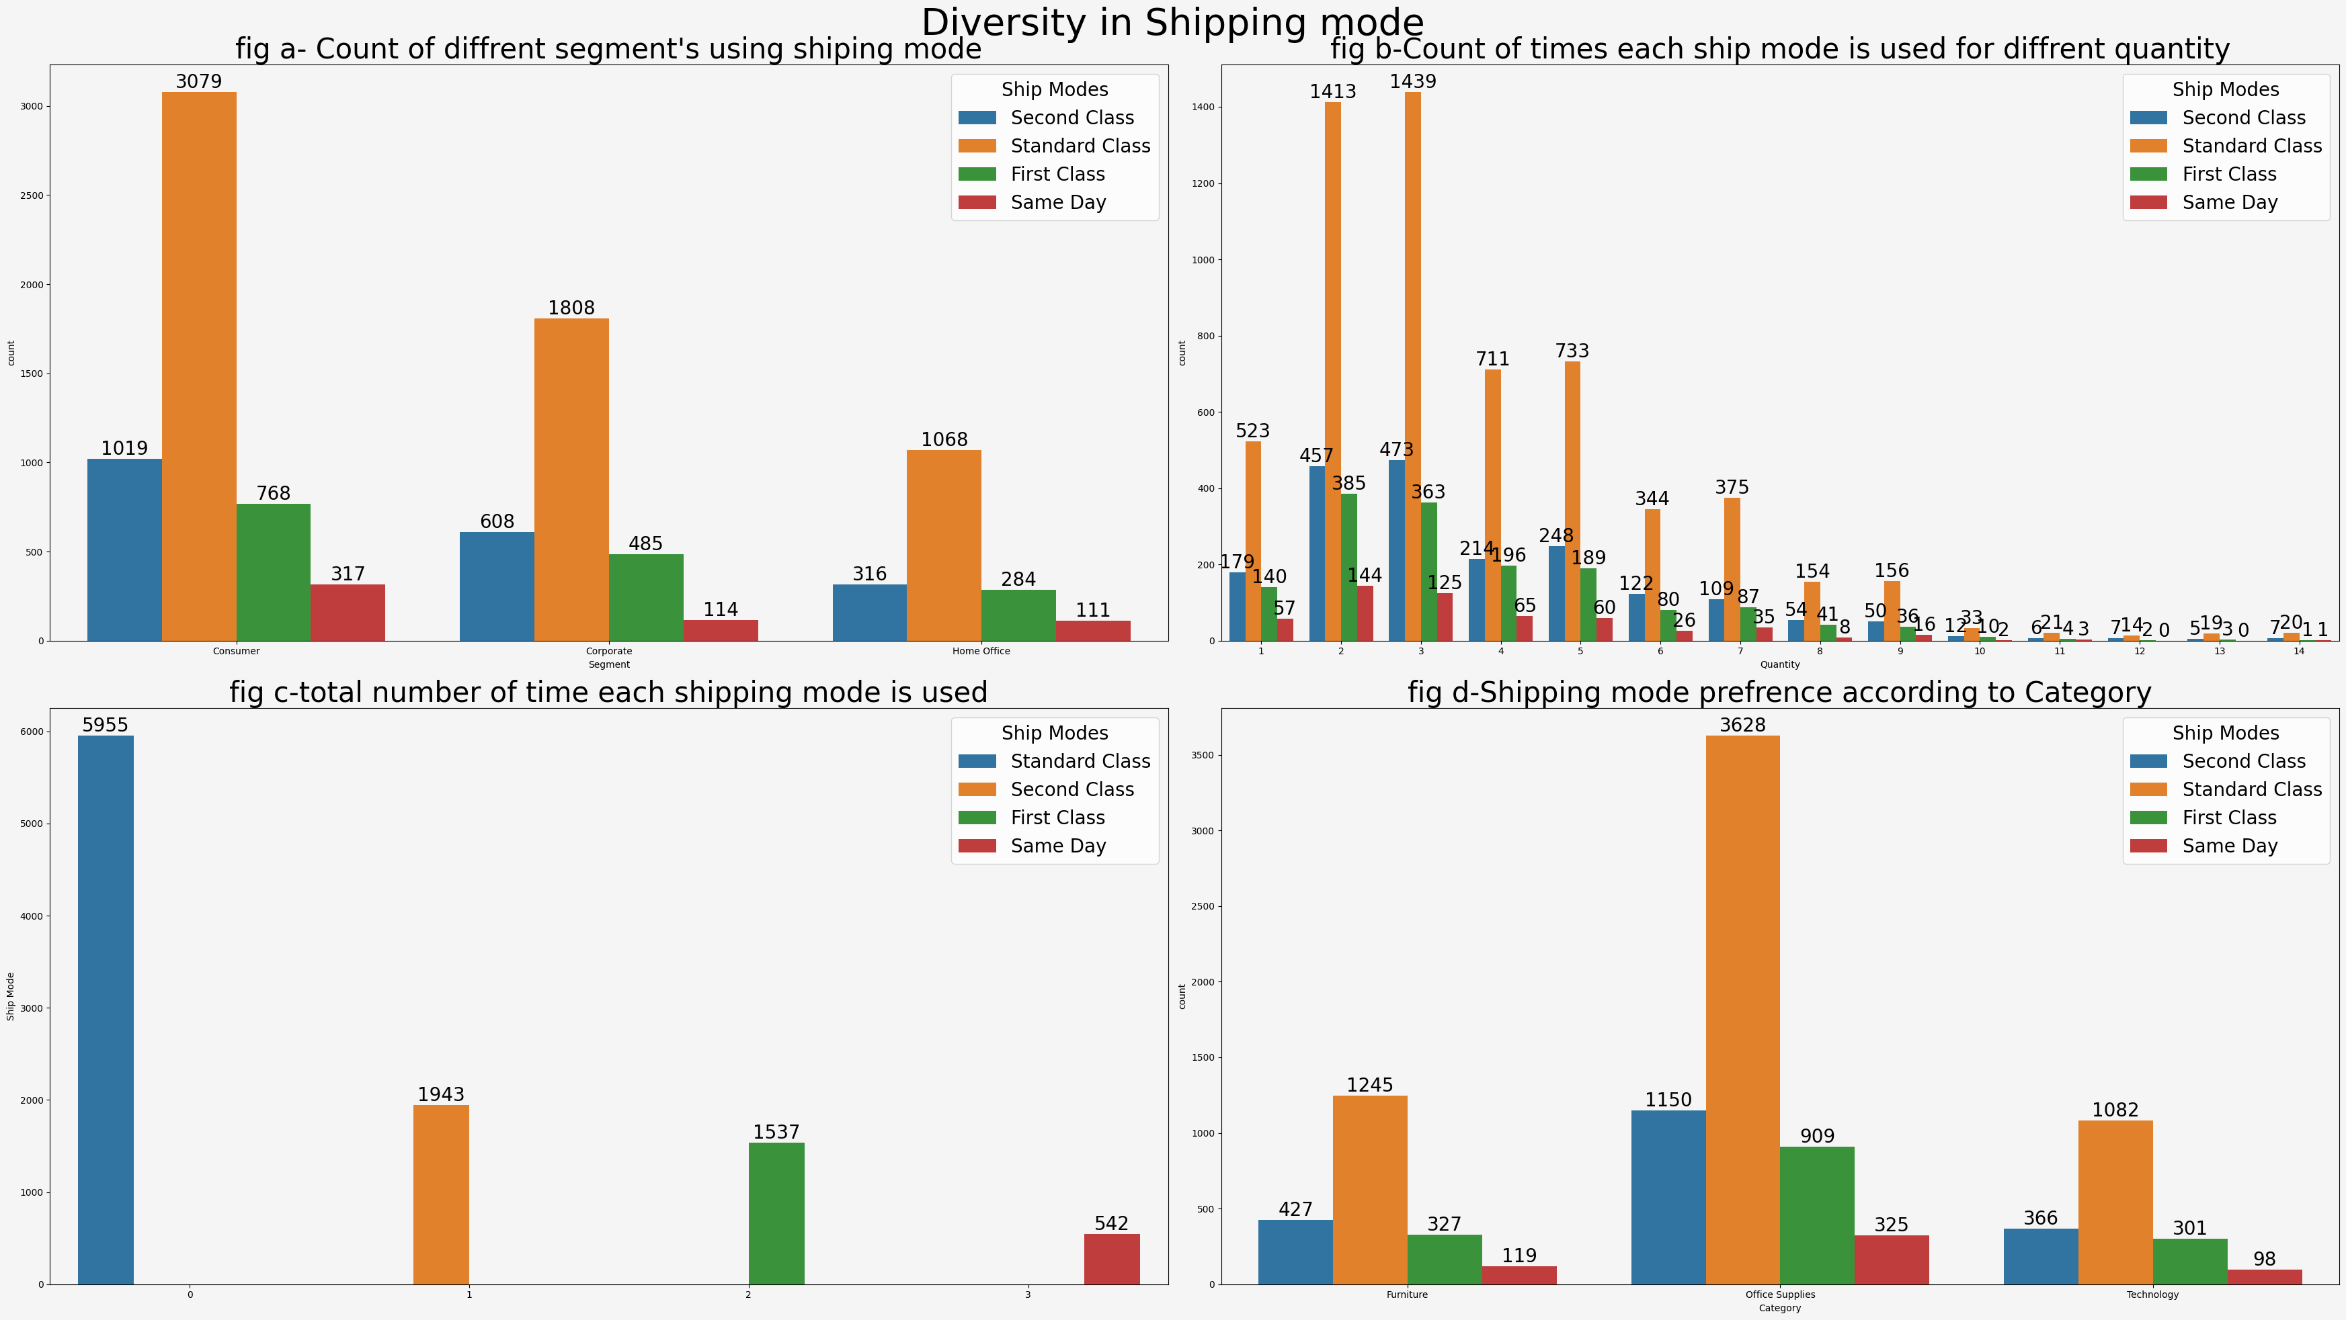
Buyers Diversity in "Ship Mode“
1. What is the most popular ship mode among buyers?
"Standard Class" mode of shipping is the most preferred. Approximately 60% of the items purchased from Superstore are shipped using this mode.
"Second Class" and "First Class" modes, with a difference of only 410 orders between them.
least preferred mode of shipping is the "Same Day" mode.
preference for the "Standard Class" mode can be attributed to its affordability compared to other modes that offer different services at higher costs.

Slide 10
Buyers Diversity in "Ship Mode“
2. Which segment of buyers utilizes each ship mode the most?
"Standard Class" mode is preferred by all segments of Superstore customers

Slide 11
Buyers Diversity in "Ship Mode“
3. Does the number or kind of an item affect the buyer's preference for shipping?
item quantity and type reveals that they do not significantly affect the buyer's preference for a particular shipping mode.
The proportions of orders shipped using each mode across three categories remain similar, indicating that the number or type of items being shipped does not play a significant role in determining the preferred shipping mode.

Slide 12
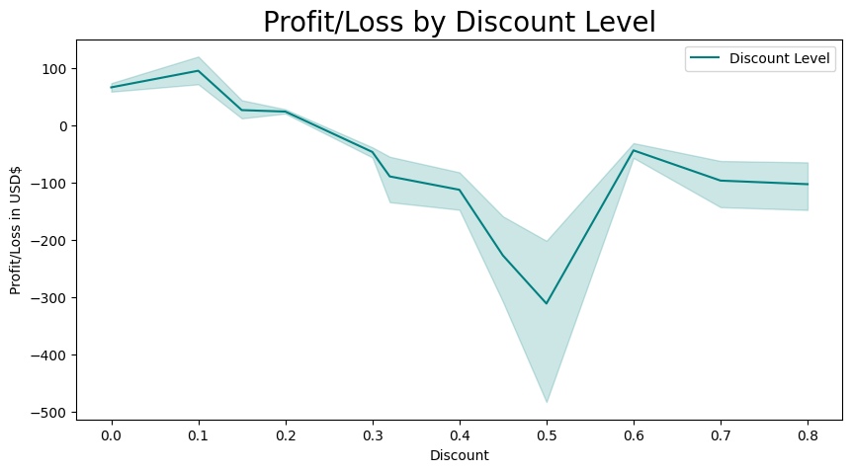
observe the effect of discounts on profit/loss
above 20% are likely to result in losses for Superstore. Can generate profits within the 0% to 20% discount range.
Customers may associate such deep discounts with product defects or low quality. Consequently, this perception can have long-term consequences for Superstore's brand image.
Maximum loss at 50% discount
the highest profitability when discount levels are below or at 10%.

Slide 13
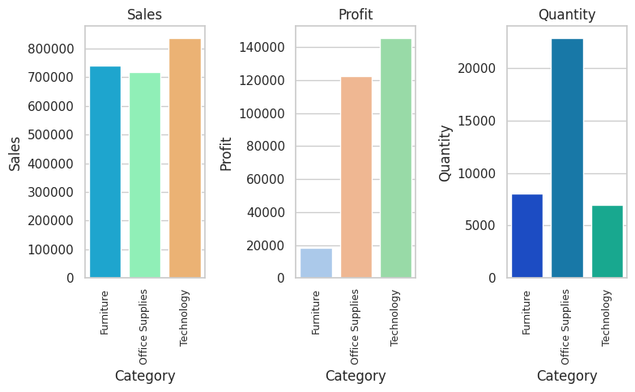
Which Category is Best Selling and Most Profitable?
Sales performance : All three categories—furniture, office supplies, and technology—brought in about the same amount of money. But sales in the Technology area were a lot higher than sales in the other two categories.
best-selling area turned out to be technology, which did better than both furniture and office supplies.
Profitability : the profit margin on technology goods is higher than the margins on products in the other two categories.
Sales Quantity :There weren't that many items sold in the Technology area. This is because technology goods are usually thought of as one-time purchases with a longer life span, usually 4 to 5 years. Even though the number of items sold is smaller, the high profit makes up for it.

Slide 14
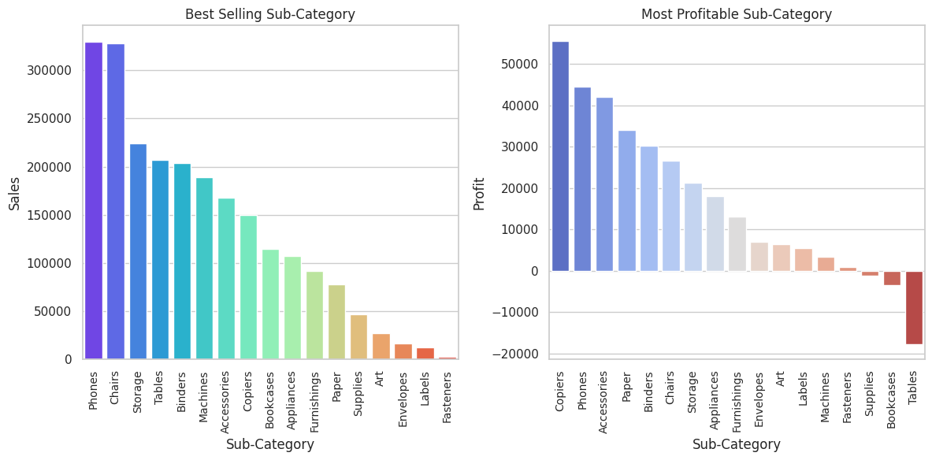
What are the Best Selling and Most Profitable Sub-Category?
Best Selling Sub-Categories : The bar plots(Fig.1) show that the two best-selling sub-categories are Phones and Chairs. Customers want these goods a lot, which points to a profitable market opportunity.
Profitable Sub-Categories : Copiers stand out as the most valuable product in the subcategories because they make the most money (Fig.2). Phones, accessories, papers, and binders all make a big difference in the total profit.
Fig.1
Fig.2
Fig.2

Slide 15
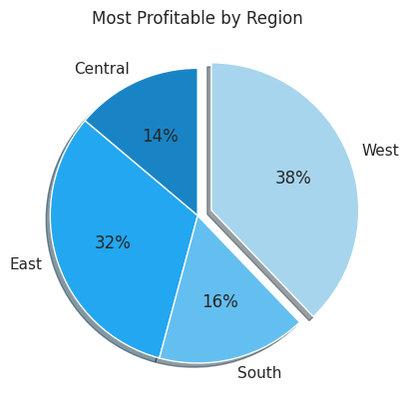
Which Region is the Most Profitable?
West is the most profitable area, with a 38% share
After that comes the East area, which has a significant 32% of the profit.
14% of profits come from the Central area, which is a much smaller share.
16% of the general profit comes from the South.
both the East and West are the most profitable areas, with the West being the most profitable. Based on these results, it seems like putting resources and business operations in these two areas could bring in the most money.

Slide 16
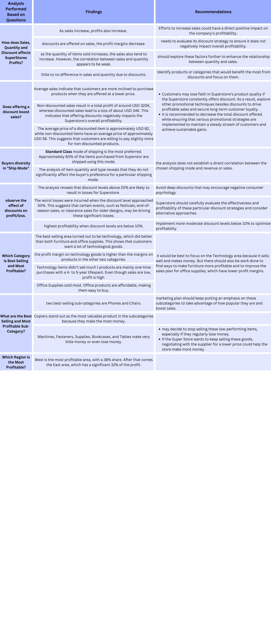
Results

Slide 19
links
For further exploration and reference, please find below relevant links and resources associated with our project:
GitHub Repository – https://github.com/rakshit232001/IBM
Dataset – https://www.kaggle.com/datasets/bravehart101/sample-supermarket-dataset
Online Courses - https://skills.yourlearning.ibm.com/activity/PLAN-311C8650DD11
Reference Video - https://skillsbuild.edunetworld.com/courses/da/superstore/
Websites - https://www.mygreatlearning.com/blog/understanding-data-visualization-techniques/

Slide 20


